Slide 1
Systems Thinking Basics
Approaches, tools and techniques
David Todd (Managing Partner)
17-05-2022

Slide 2

Synergia

Slide 3
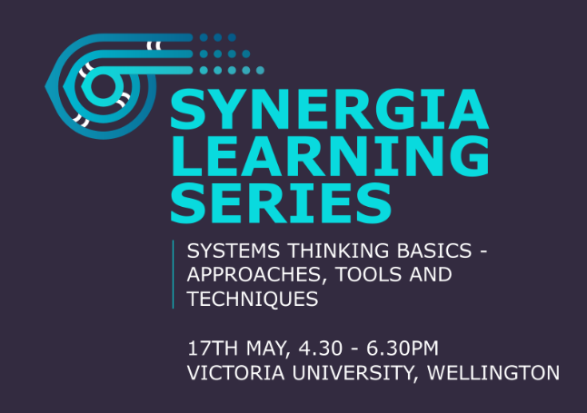
Synergia Learning Series
Implementation Science
No link
Creating a Data Commons – better decision making through integrated data
https://synergia.consulting/news/creating-a-data-commons/
Mātauranga Māori and Systems Thinking
https://synergia.consulting/news/matauranga-maori-and-systems-thinking/
Systemic Approaches to Obesity Prevention
https://synergia.consulting/uncategorized/systemic-approaches-to-obesity-prevention
Maximising the value from evaluation
https://synergia.consulting/news/maximising-the-value-from-evaluation/

Slide 4
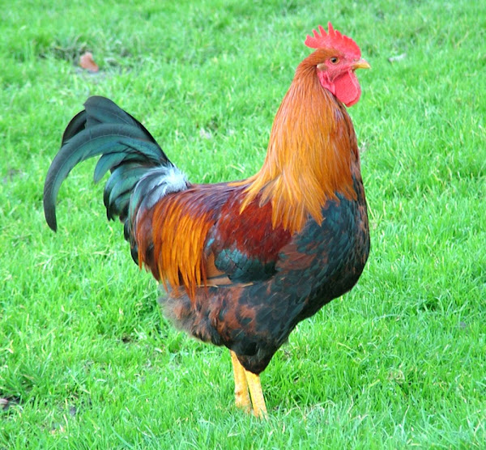
Tonight
A bit of theory – not too much
Explore a set of practical tools
Why and how to use
Do some practice
Reflect, learn and share
Roosters will feature a bit – I will explain

Slide 5
Systems Thinking
A Crash Course

Slide 6
Why Systems Thinking?
Environment is complex
Overlapping policies and targets
Pathways cut across multiple organisations
Leverage points hard to identify
Lots of data and information
People saying “we must understand the whole system”
There are tools/techniques that can help
Systems Thinking and System Modelling

Slide 7

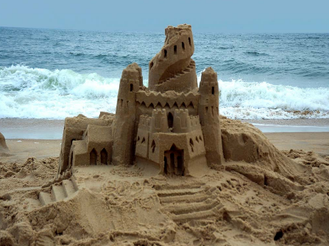
What is a System?
In its simplest form a system is a collection of parts which interact with each other to function as a whole
More than the simple accumulation of its parts
Cutting a system in half does not give you two systems
Systems are complex - particularly social systems
Notes:
Two piles. Use a spade to make 3 piles or 4 piles
Key difference with systems is that they are organised
The parts interact, following rules, conditions etc to form something ‘a system’
Another important characteristic is that people attribute meaning to systems – you may say this is castle, some people see this as a church
Castles have a particular cultural history for different people – if I was Maori and telling this story my images are likely to be different showing a marae or waka

Slide 8
Why are things complex
Messes
Puzzles
Problems
Formulation - agreed
Solutions - agreed
Formulation - debatable
Solutions - debatable
Formulation - agreed
Solutions - debatable
Life
Chess
Jigsaw
Notes:
Especially with problems and messes you can’t do it on your own – Systems Thinking is not a solo endeavour. Systems Thinking implies co-design and surfaces peoples perspectives, viewpoints etc.
Messes are real and you need tools that embrace the mess and help you understand it

Slide 9
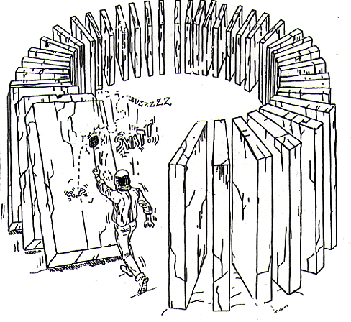
Feedback, delays and unintended consequences
Our actions have unintended as well as intended consequences
…which often feedback on ourselves

Slide 10
Our history and our future are connected
target
today

Slide 11
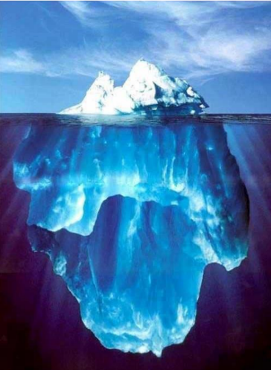
What really drives performance?
Events
Today’s pressure: waiting lists
Patterns
today
Structures
A
B
C
D
Mental Models
View of the world – what’s important
Notes:
We often get brought in because of an event
To do our work we need to go down
To design systems we need to start at the bottom

Slide 12
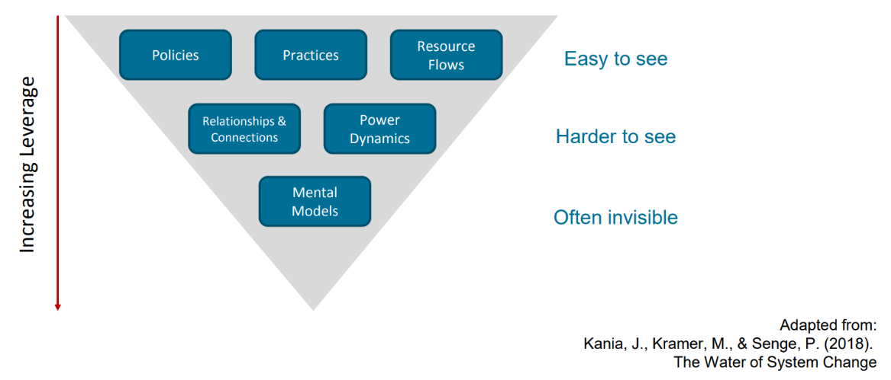
Seeing the system conditions

Slide 13
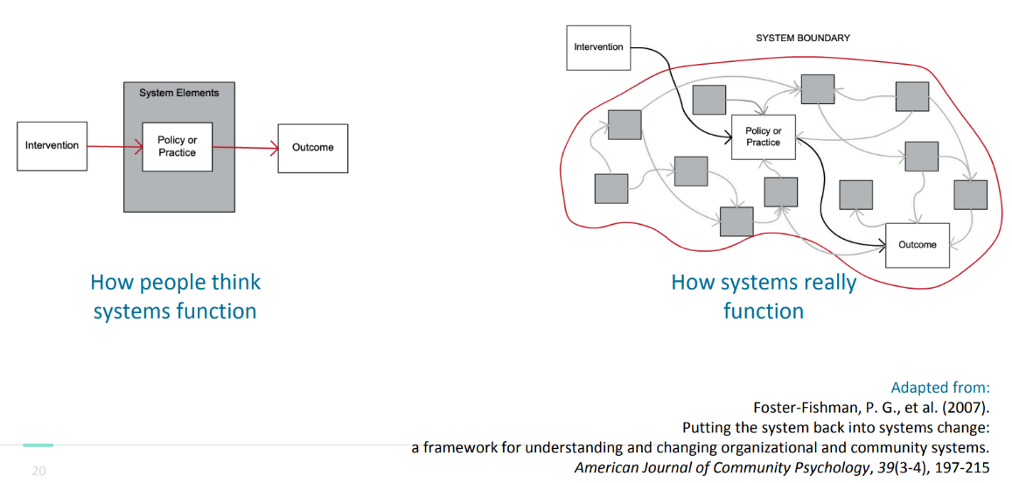
Mental Models Driving Interventions
Notes:
Assumes linear chain of cause and effect. Policy will directly lead to an outcome and action can be broken into separate bits to achieve the outcome
Need to understand the context within which it takes place and knowing the context and how it will impact/or not

Slide 14
Summary
Systems Thinking offers a framework and methodology and set of tools that has evolved expressly for building understanding about complex systems
It increases our awareness of the full consequences of our actions so as to increase the likelihood of achieving and sustaining our intended consequences
There is feedback which is often dynamic and can break the logical chain of action-reaction
They behave over time (history and future)
Structure drives behaviour and performance
Systems have boundaries
We need tools and frameworks to help us understand them and make decisions

Slide 15
Tools

Slide 16
Tools
Practice today:
Boundary judgements
Reference behaviour patterns
Causal loop diagrams
If we have time there are more:
Stock and flow models
Rich pictures
Root definitions

Slide 17
Tool 1: Boundary judgements
Interplay between these three areas
The person who decides the boundary judgements owns the debate
Deciding what is valued and what is not
What and what to include and who and what to leave out
System
Data
Values
Notes:
When I’m starting any work I have this in my head all the time
Can’t look at x because we don’t have the data – you are making boundary judgement about what to include or not
Boundaries are always contextual – for example in NZ Te Tiriti and Equity/Maori considerations are always within the boundary but for other countries for example Australia, cultural consideration are often not.
Boundary judgements highlight what you believe to be important or value and are always being tested
Is lived experience important, should we involve clinicians in this, what about funders, other agencies – all boundary judgements
If you exclude something you are giving it a value of 0 in your system

Slide 18
Tool 2: Reference behaviour patterns
Very simple
Start us thinking dynamically, over time and exploring patterns
How to:
  Draw an x and a y axis
  Pick a topic or variable and name it
  Add a time scale
  Bad performance at bottom (sad face), good performance at top (happy face)
  What’s past behaviour looked like
    Mark and describe the ups and downs – what happened?
  Where do you want to go in the future
  What performance is required to get there – what needs to happen?
What I hear:
We are really busy
Lots of referrals
ED is crowded
Seeing a high complexity of cases
Covid was really hard
1000 people waiting

Slide 19
Lets practice
Reference Behaviour Patterns

Slide 20
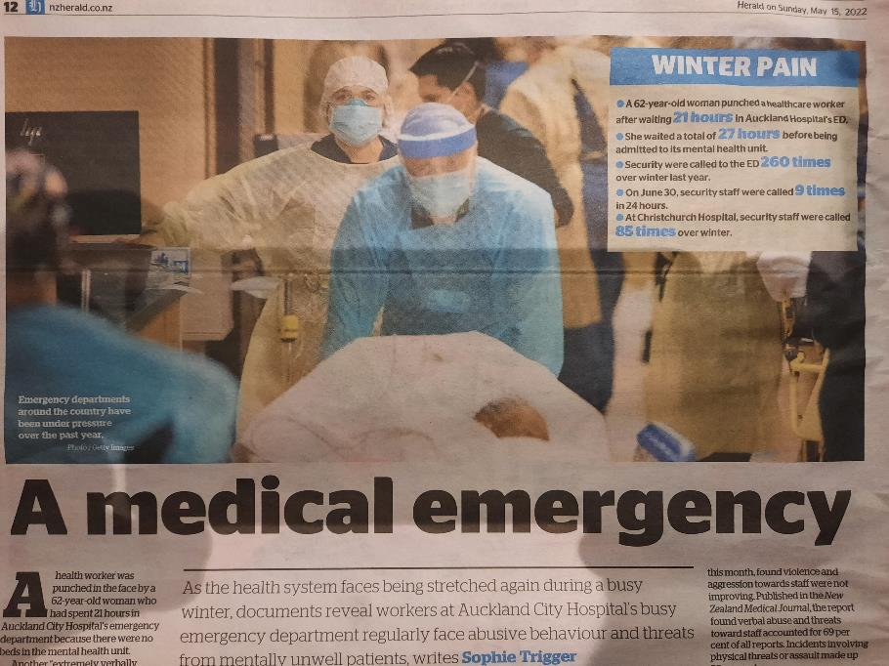
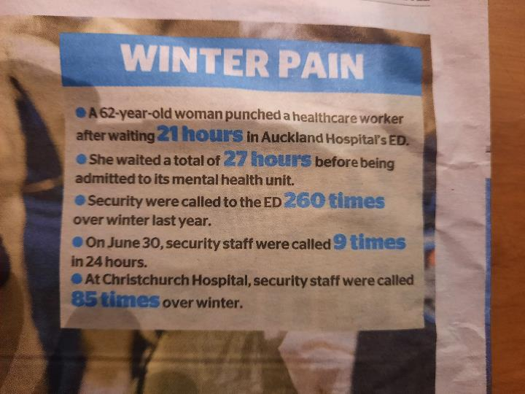

Slide 21
Reference behaviour patterns – top tips
Snapshots to movies
When a colleague makes an ‘event’ statement ask questions such as “has the situation been getting better, worse, staying the same?
And what would good or better performance look like?
Make sure you label the changes in pattern – what caused the pattern to change?

Slide 22
Tool 3: Causal Loop Diagrams
Help to understand what is causing the behaviour we see. Helps us start to dig into the ‘structure’ of the system and understand the ‘mental models’
The complex system for today is:
  The chicken and egg system
No.
chickens
eggs
Time
Reinforcing feedback loops generate “runaway” behaviour
(they reinforce in the same direction of change).

Slide 23
Be careful crossing the road
No.
+
chickens
-
road crossings
Time
Counteracting or balancing feedback loops generate “homing in” behaviour
(they resist change; push them one way, they push back the other).

Slide 24
A complex system in action
What are the dynamics of the chicken population when both loops are active simultaneously?
Sketch a behaviour over time graph showing the behaviour of the chicken population over time. Assume the initial population is 10 chickens - but includes at least one rooster.

Slide 25
Lets practice
Causal Loop Diagrams

Slide 26
Causal Loop Diagrams – top tips
Always focus on closing each loop
Do not proceed with more variables until you have closed each loop
Use the diagram to tell a systemic and connected story
Practice by taking a newspaper article and mapping out the dynamic that you believe is happening – no wrong answer just a good way to practice
You may have 2 or 3 versions for same article – its OK to have different perspectives on same issue

Slide 27
Some more tools
If we have time

Slide 28
Stock flow maps
Use to rigorously map systems and if needed can be numerated to support dynamic simulation modelling
Test range of alternative policies/strategies for consistency and robustness before implementation and without risk
Develop and communicate a shared understanding
Support a dynamic planning conversation
A model does not produce one right answer. Allows us to test a range of factors and assess their impact on the system
It is challenging yet rewarding

Slide 29
Building Blocks
The four basic building blocks of the System Dynamics language...
Stock
Flow
Converter
Connector

Slide 30
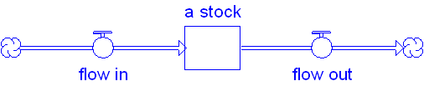
Building blocks: Stocks and flows
People going onto list People starting a service
New recruits
Matriculating
Becoming avail for work
Income
People waiting
People using a service
People in post
On a course
People seeking work
Bank Balance
Starting a service
Ceasing using service
Turnover
Graduating
Being recruited
Expenditure

Slide 31
Building Blocks: Stock and Flows
Stocks have a tendency to accumulate, their behaviour varies over Time, depending on what flows in or out
Flows tend to exhibit greater fluctuations and variability
a useful method to deal with processes that have multiple stages or states, combined with time factors / delays
Captures structure of a System better than a Spreadsheet (blocks of figures in rows and columns give little sense of structure or dynamics)

Slide 32
Building Blocks: Connectors
• Connectors carry the information which generate flows.
Water in Cup 1
Water in Cup 2
pouring

Slide 33
Building Blocks: Converters
Water in Cup 1
Water in Cup 2
Converters are “catchalls.”
They are used to:
  Represent external inputs.
  House relationships between variables.
pouring
Gap
Cup 2 Target

Slide 34
Examples of Feedback Loops
When I’m tired, I sleep.
The more I work, the further behind I get!
Backlog of Work
incoming
completing
(B)
~
(B)
productivity
Hours Per Day
(R)
~
adjusting hours
Burnout
A simple demo
building up

Slide 35
An example
Simple SD Model

Slide 36
Another example – hospital bed modelling
What are we doing to influence this flow?
People often forget about this flow
Number of Beds
in
out
90% of effort
10% of effort
Can we slow it down?
Are there alternatives?
Can we speed this up?
What is causing this flow to not work?
The levers are often far away in distance and time than where the problem is perceived to be

Slide 37
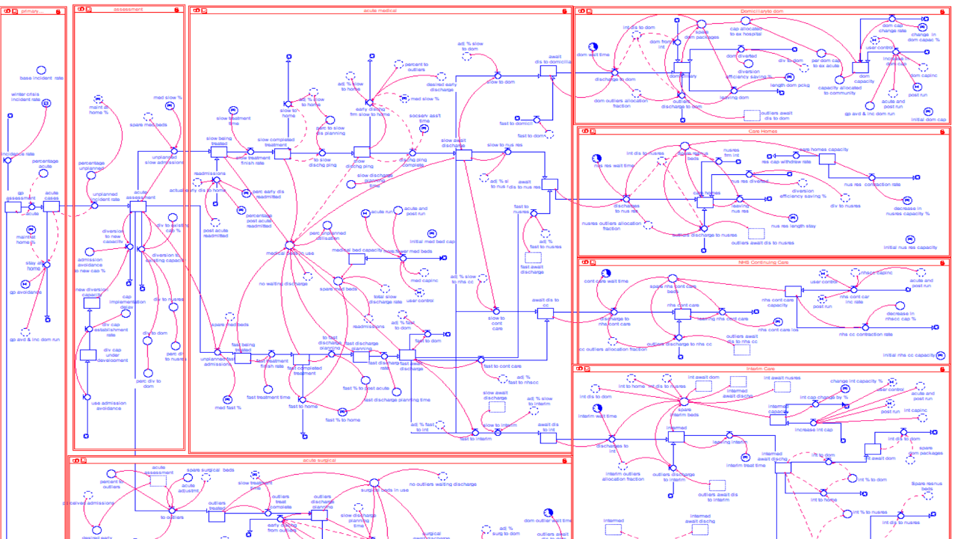

Slide 38
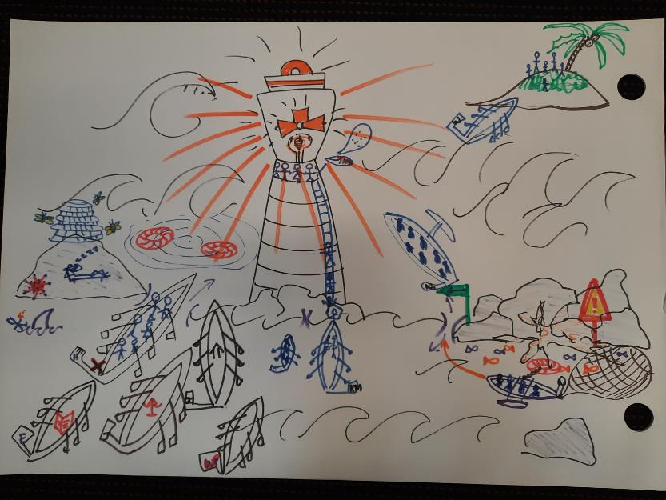
Rich pictures
Great way to get people thinking systemically
To tell a connected story
To explore causality and relationships between ideas
Lots of fun

Slide 39
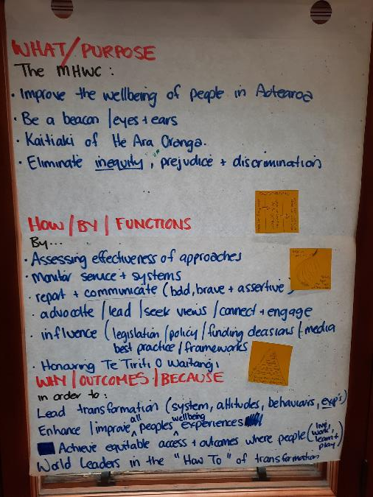

Root definition
A system that: (has a purpose)
By: (doing some things)
In order to: (achieve goals or outcomes)

Slide 40
Final word

Slide 41
Final word
Events
Couple of tools to start thinking systemically
Help move thinking from events, through patterns, to structure, to understanding mental models
Aim is to develop insight and understanding not the right answer
To increase your proficiency you need to practice and apply on a real issue
Everyone’s view is partial and biased and that’s OK – important to surface mental models
All models are wrong, some are useful
Patterns
Increasing leverage
Structures
Mental Models

