Slide 1
Putting social investment to work
Synergia Learning Series
Paul Stephenson
Carl Bakker (Acuo)

Slide 2
Kia ora
‘Learning’ series – so please ask questions and contribute to the discussion
Introductions – one purpose is building networks
Social investment update
Case study and learnings from Genesis Youth Trust – social bond pilot (two perspectives)
Components of an ecosystem for faster and better social bonds
(Timing)

Slide 3
Introduction
Carl Bakker – Managing director Acuo (economic consultancy) and Chairman, G-Fund Limited (financial intermediary for the Genesis social impact bond)
Paul Stephenson – Synergia Partner, lead consultant for Genesis social impact bond.

Slide 4
Social investment back on the menu

Slide 5
National backing social investment
Nicola Willis
Minister of Finance and Minister of Social Investment
Chris Bishop
Minister of Housing
Excerpts from National Party Policy (Social Investment Fund)
“Social investment will be the organising framework for the next National Government’s approach to the funding and delivery of social services.
“The next National Government will bring the Social Investment approach back to life.
“National’s Social Investment approach will identify, fund and scale up the actions that will have the most positive impact on people in the long run. It will make use of sophisticated data and evaluation approaches to identify what works and, crucially, what doesn’t.
“This bold new approach to delivering social services will be supported by a new Social Investment Fund. In time, National would also consider opening the Social Investment Fund to investment from New Zealanders seeking positive social change for the disadvantaged.
“National want results. If private capital can be better deployed to help change the lives of more New Zealanders, we will not be afraid to use it. “
Pre-election Housing policy statement
“Establish a Social Impact Bond through the Social Investment Fund to partner with providers who can shift families out of emergency housing into secure homes in the short-term – and keep them there in the long-term. Payments will reflect the long-term aim of ending emergency housing and providing better outcomes for vulnerable families. An initial bond of $50 million will be established from unspent funding for Labour’s Emergency Housing ‘reset’.”

Slide 6
What is social investment?
Social investment
Impact investment
Social impact bonds

Slide 7
Social investment defined
Social investment is the use of repayable finance to help an organisation achieve a social purpose.
Charities and social enterprises can use repayable finance to help them increase their impact on society, for example by growing their business, providing working capital for contract delivery, or buying assets.
Social impact investment (SII) -- the provision of finance to organisations addressing social needs with the explicit expectation of a measurable social, as well as financial, return -- has become increasingly relevant in today’s economic setting as social challenges have mounted with public funds in many countries under pressure. New approaches are needed for addressing social and economic challenges, including new models of public and private partnership which can fund, deliver and scale innovative solutions from the ground up.
Social Investment is about improving the lives of New Zealanders by applying rigorous and evidence-based investment practices to social services.
It means using information and technology to better understand the people who need public services and what works, and then adjusting services accordingly. What is learnt through this process informs the next set of investment decisions.
Much of the focus is on early investment to achieve better long-term results for people and helping them to become more independent. This reduces the number of New Zealanders relying on social services and the overall costs for taxpayers.
Social Investment puts the needs of people who rely on public services at the centre of decisions on planning, programmes and resourcing, by:
  Setting clear, measurable goals for helping those people;
  Using information and technology to better understand the needs of people who rely on social services and what services they are currently receiving;
  Systematically measuring the effectiveness of services, so we know what works well and what doesn’t;
  Purchasing results rather than specific inputs and moving funding to the most effective services irrespective of whether they are provided by government or non-government agencies.

Slide 8
What is a social impact bond?
The Government Outcomes Lab at Oxford University defines impact bonds, including SIBs, as follows:
“Impact bonds are outcome-based contracts that incorporate the use of private funding from investors to cover the upfront capital required for a provider to set up and deliver a service. The service is set out to achieve measurable outcomes established by the commissioning authority (or outcome payer) and the investor is repaid only if these outcomes are achieved.”

Slide 9
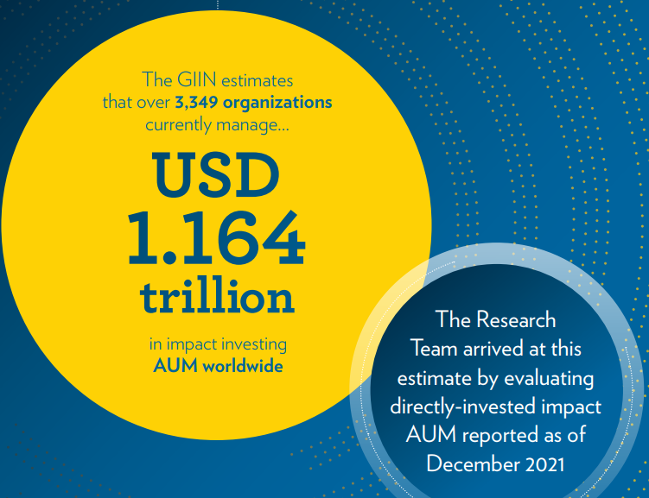
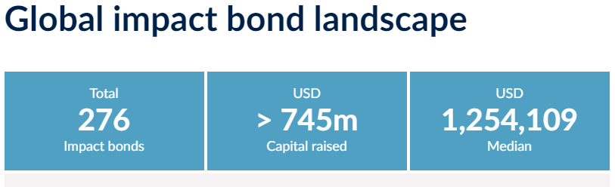
Trends internationally
Global position- Impact investing

Slide 10
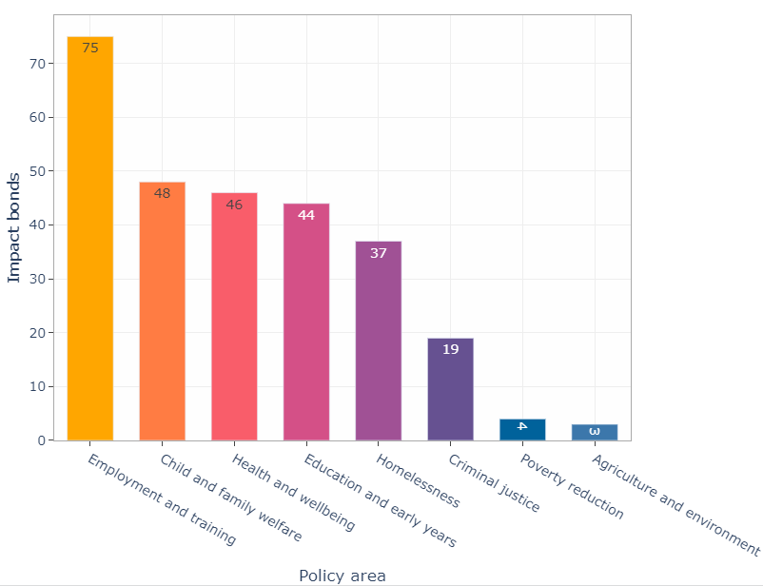
Global impact bonds by policy area

Slide 11
Genesis Youth Trust Social Bond- case study and learnings

Slide 12
Case study Genesis SB - outline
What was intended with this social impact bond
As per the 2017 commissioning Cabinet paper it was:
“a social bond designed to reduce youth reoffending in South Auckland…
The bond offers significant benefits:
  1: Innovations in the approach to tackling young offenders, an area where in New Zealand and internationally results have been poor … and
  2: Potential learnings about how to effectively design and manage innovative approaches to contracting for (and achieving) better social outcomes…. and
  3: While the degree of innovation and a long tail of possible outcome improvements mean it is difficult to precisely forecast the overall cost-benefit for the Crown, it is expected to be positive and is coupled with a risk management mechanism that protects the Crown if the intervention is not successful.”

Slide 13
The Reduction in Youth Reoffending Social Bond
What: A social impact bond, to reduce reoffending by young people, through multi-disciplinary services to medium and high-risk offenders; planned to enrol 1000 youth aged between 13 and 17 who had already offended
Where: South Auckland, New Zealand
When: 1 September 2017 to 31 August 2023 - just finished
Who: Payment by the NZ Government, through the Oranga Tamariki, with services provided by the Genesis Youth Trust- a not-for-profit trust. Payments capped to $24m over the life of the bond
Contract managed by G-Fund, a financial intermediary that was part of Genesis but independent.
Initial bond funding of NZD$6m, raised from five private sector funds
Key contractual terms: Payments primarily dependent on outcomes that were better than historic counterfactuals, based on reoffending rates and severity. Measurement relied on NZ Police’s offending data. Some additional payments via intermediate outcomes, reductions in assessed criminogenic risk
What happened? Significant reductions in reoffending, bond holders repaid capital and interest to capped levels.

Slide 14
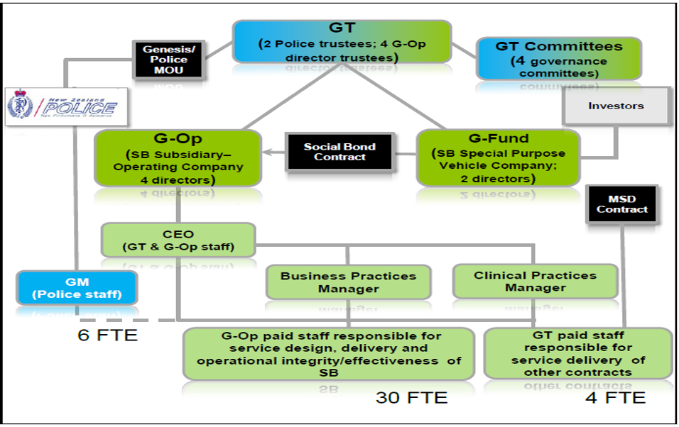
Genesis social bond contract structure

Slide 15
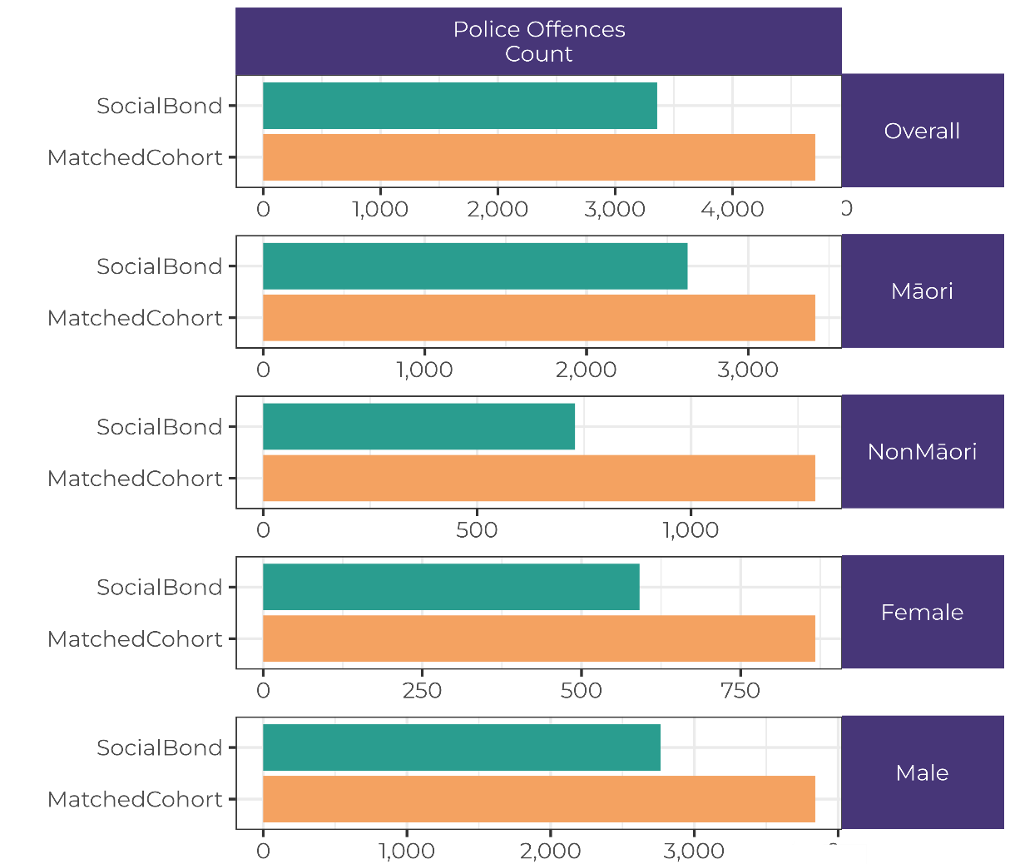
What reoffending outcomes were achieved?
Reoffending down by 30% cumulatively

Slide 16
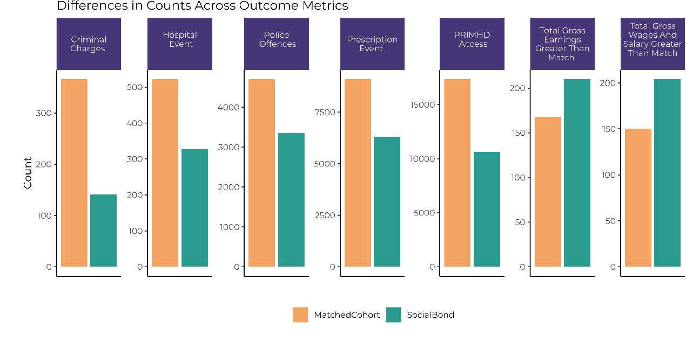
What was achieved:
Improvements across multiple wellbeing domains

Slide 17
Social value created

Slide 18

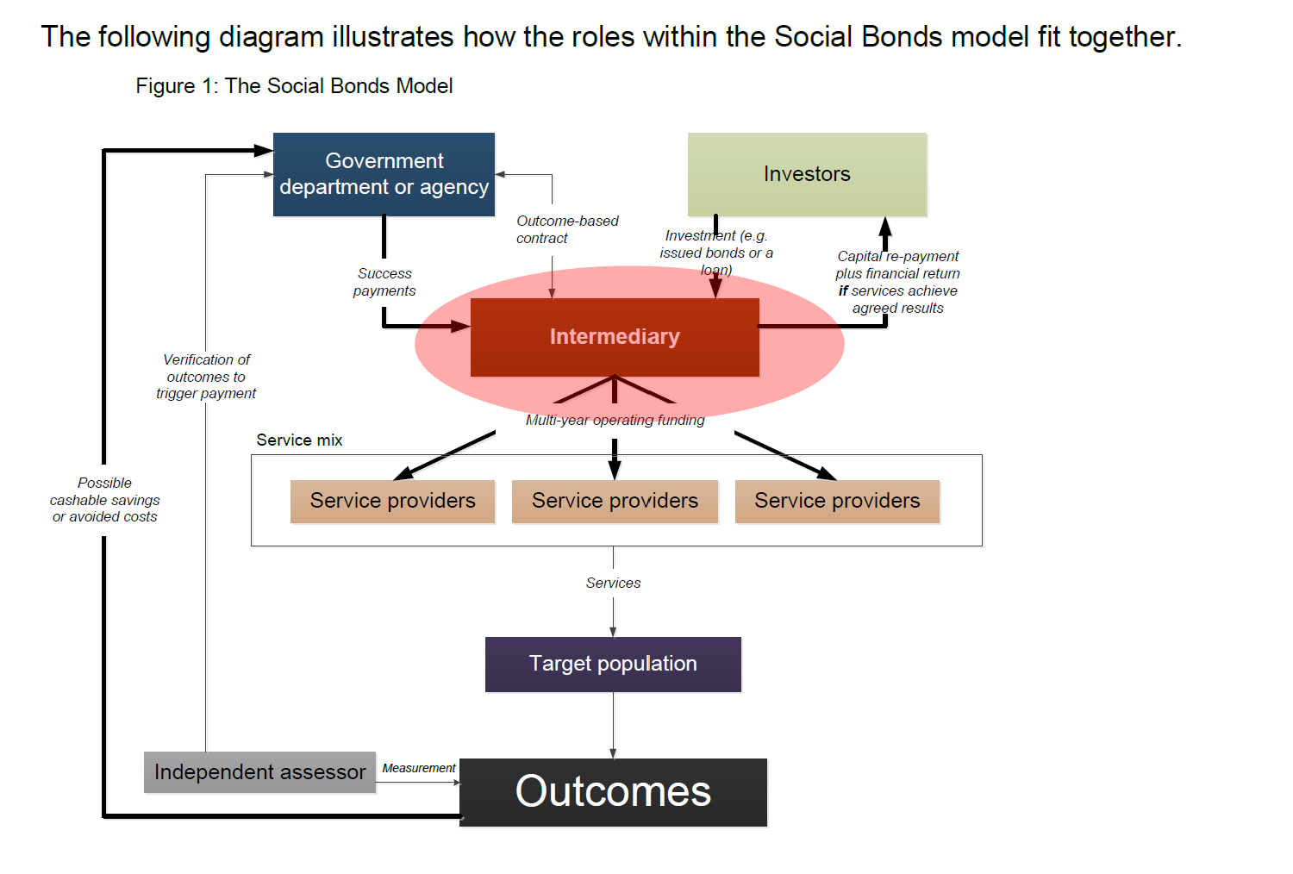

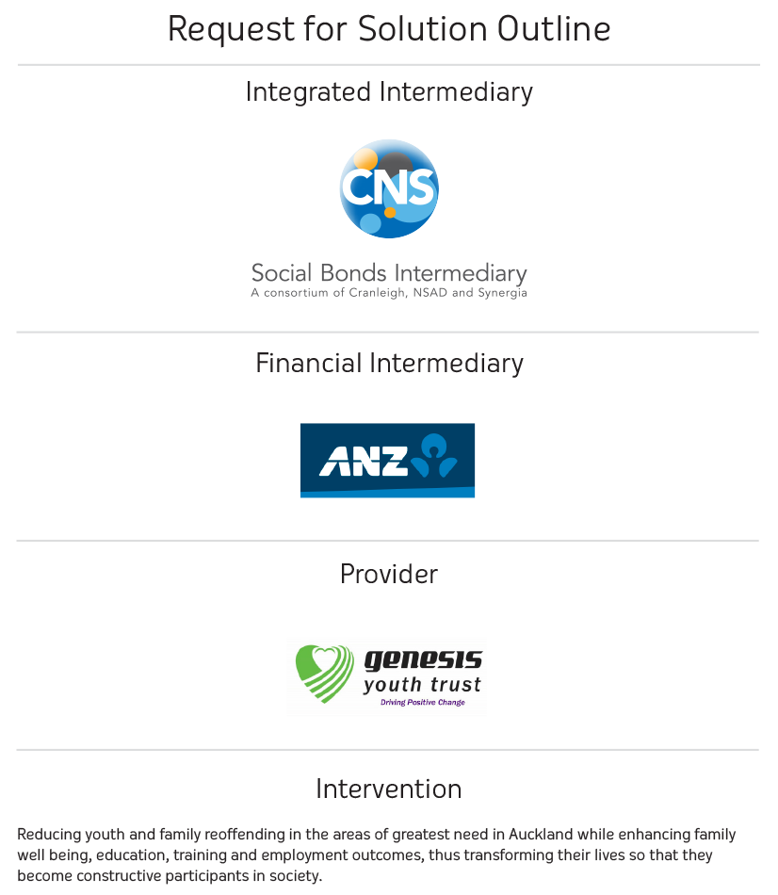
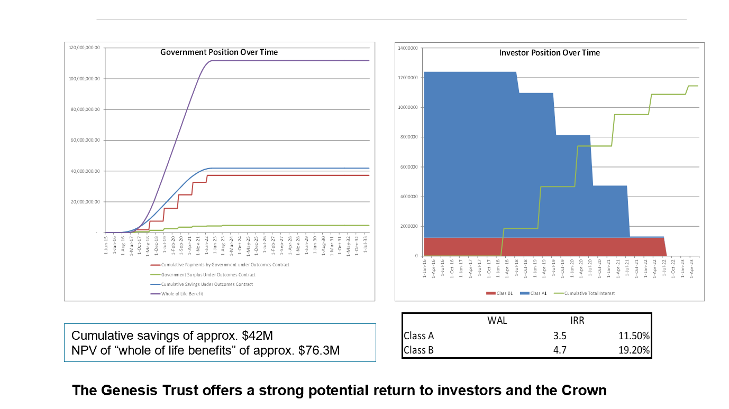
The genesis of the Genesis bond

Slide 19
My SB state-of-mind roller coaster

Slide 20
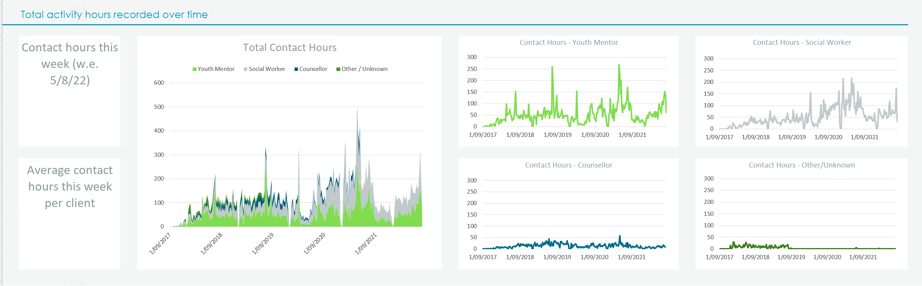
Genesis operational model
Youth offenders from Police (13-17)
Assess and enrol
Support time to 2 years/ more intensive
Social worker, mentor and counsellor combo
Hearts and minds
YLS-CMI – criminogenic risk factors
Ongoing assessment
New peer networks
Links to Police
Excellent data

Slide 21
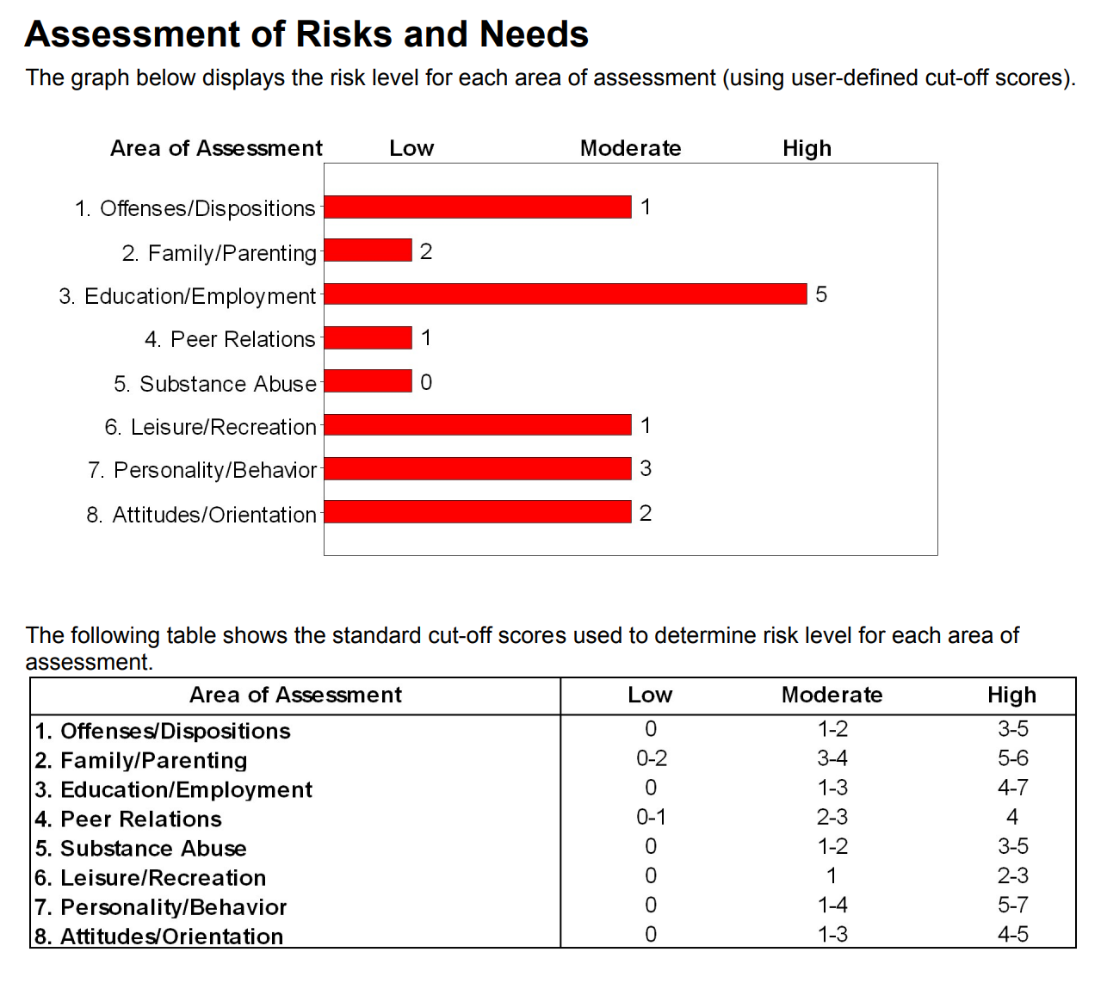
Critical role of YLS-CMI
International validated tool
Evidence-based
Assess criminogenic risks – develop plans – focus effort
Review progress/change
Drive SB payments – especially first two years

Slide 22
How we operationally used data
See dashboard

Slide 23
Learnings
This bond has demonstrated the potential to make very large gains in wellbeing through better contracting approaches, potentially applicable across a variety of social services.
Spend time doing the initial policy analysis and identification of which outcomes matter: it’s crucial.
Although the key outcomes might be narrowly defined, often a programme might deliver a wider set of wellbeing improvements.
Often while the most important outcomes are longer-term there is a need to develop some interim outcome measures that indicate progress is in the right direction.
While they can be risky, outcome-based contracting offer a chance to make transparent- and improve- outcomes for groups not well served by existing government programmes.

Slide 24
Learnings
Long experience and powerful passion of front-line staff can be informed by the judicious creation and use of data to make changes that deliver better outcomes and improve lives.
Don’t underestimate the required cultural and structural changes that moving to outcome-based contracting can mean. This affects the often small scale not-for-profit providers as well as government agency staff.
A supportive system needs to be put in place to deal with the complexity of outcome-based contracts.
Longer-term contracts are often required to support the additional investment in new service models and the supporting data and analytical tools.

Slide 25
Learnings
This novel outcome-based contract, spanning multiple departmental areas of interest, would not have occurred if development of the initiative had been left to any of the line agencies responsible across the youth justice space.
Within-government structural options and financing arrangements need to be adopted that expedite new outcome-based contracts.
There is a need to shift the incentives on departmental chief executives and their staff so that innovative and cross cutting contracts like SIBs receive genuine support at all points of linkage.
We can expect greater interest from NZ financial markets in this sort of contract given its success and international trends.

Slide 26
Looking forward

Slide 27
From bureaucratic to systemic

Slide 28
Problem solving machines

Slide 29
Better and faster
Building a thriving social bonds ecosystem will take time and require sophisticated infrastructure.
But don’t wait until everything is perfectly in place.
Focus on the ‘the deal’ to get moving and build an outcomes focused culture. Create the infrastructure as you go.

Slide 30
Practical steps to getting going
Org type | Getting moving
Provider | Identify situations where a bond solution adds value e.g. – high cost or ongoing cost (MH high & complex needs); key life inflexion point (youth crime), new insight (TBIs and incarceration). Places where change produces high value.
Intermediary | Build relationships with thought leaders, investors, funders, Iwi. Scope potential deals (who, what, how, how much, how measure, what value) and determine own role and value add.
Data support | Identify data tools, linked data skills, value methodologies. Help to optimise operations, show performance and tell value story. Be efficient and show your own value.
Investors | Conduct self-priming for social investment, opportunities, deals, risks, structures, clusters, Iwi relationships. Be open to pitches for good SB ideas and build relationships with intermediaries you can work with.
Govt funder (independent from sector agencies) | Set up min spec for bond system fast, focus on achieving deals, build as you deliver. Create the incentives, energise the market, lower compliance costs, be rock solid on specs of outcomes/impact/value. Ensure the whole system learns fast and shares.

Slide 31
Ngā mihi nui
Discussion

